Slide 1

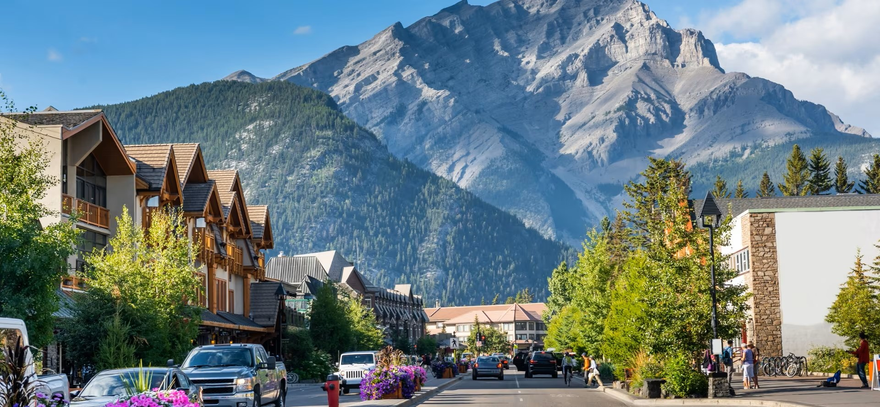
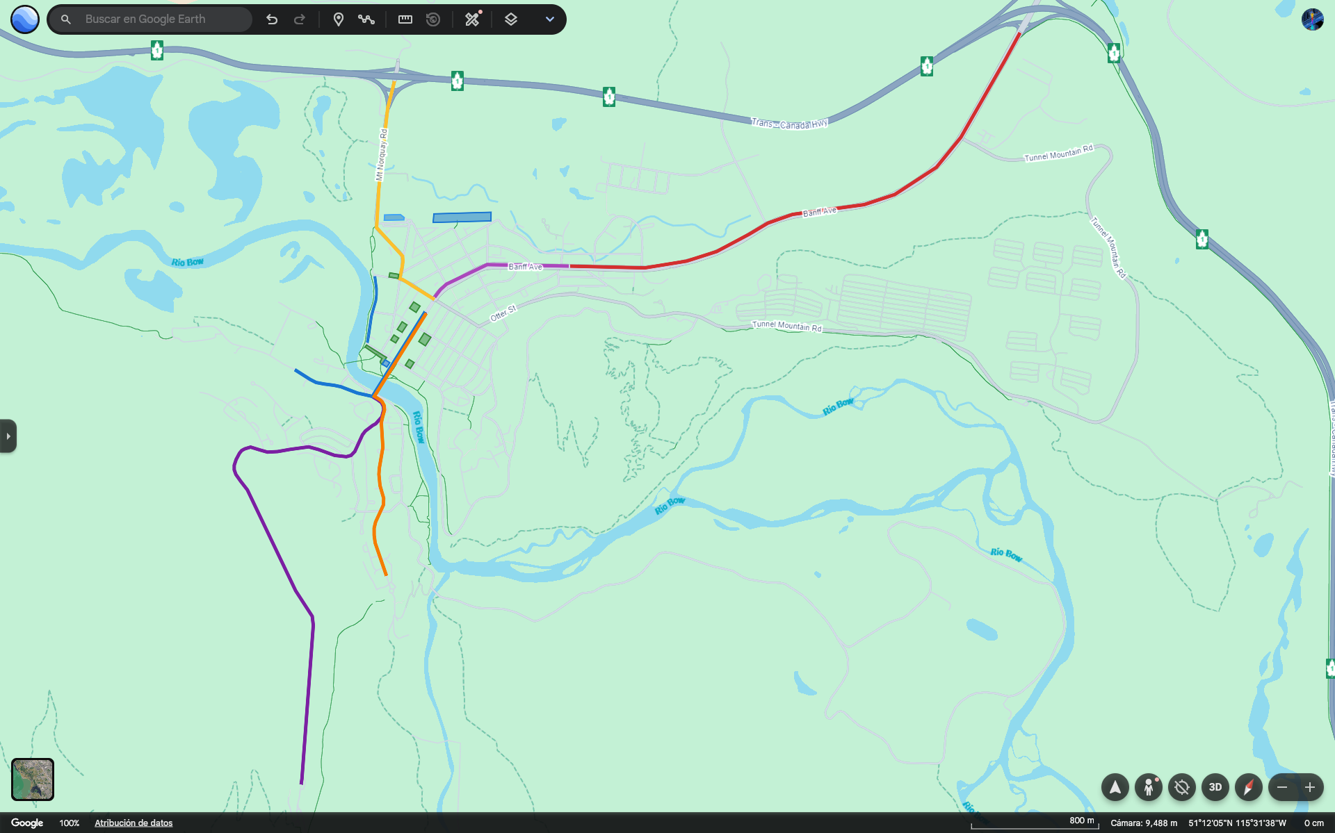
October 10, 2029
CMPT-3835-Machine Learning Work Integrated Project II
Mobility Innovator
Banff Traffic Management
Instructor Name: Uchenna Mgbaja, Palwasha Afsar

Slide 2
October 20, 2029
CMPT-3835-Machine Learning Work Integrated Project II
Mobility Innovator
Banff Traffic Management
Aquiles Escarra
Inderjeet Singh
Aditya Mehta
Yungvir Singh
Instructor Name: Uchenna Mgbaja, Palwasha Afsar

Slide 3


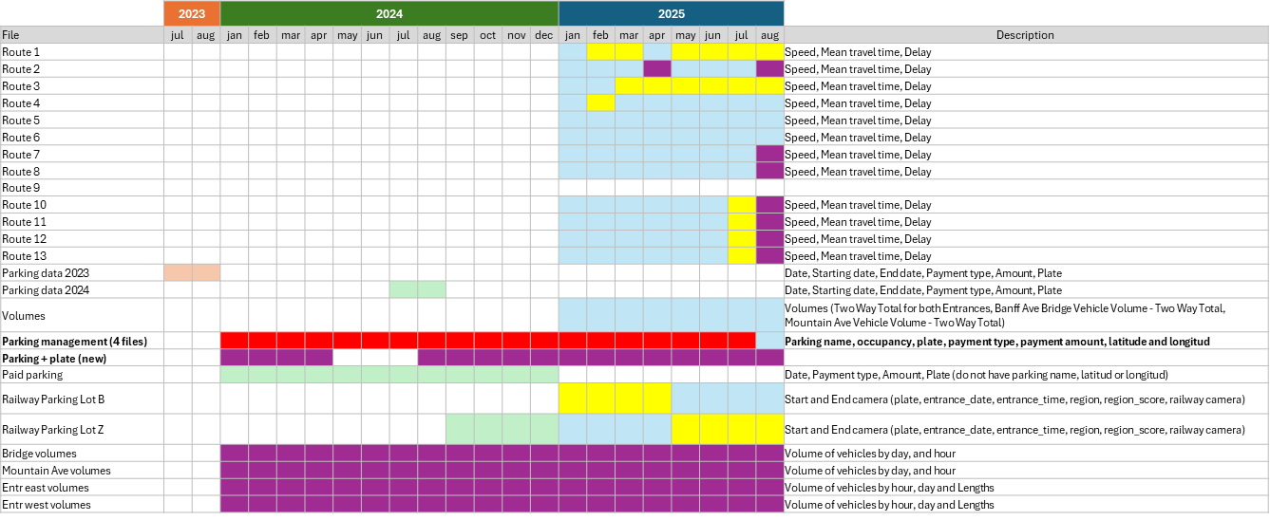

Problem Statement
Data
Regression
Predict hourly parking occupancy in Banff to understand temporal demand patterns and optimize parking availability.
Detect when parking lots reach saturation (≥90% occupancy) to support real-time management and visitor guidance.
Analyze how traffic congestion on the Bow River bridge affects parking behavior in nearby tourist and hotel zones.
Classification
Correlation / Analysis
CornerStone Solutions Inc

Slide 4
Problem Statement
Data
Regression
Predict hourly parking occupancy in Banff to understand temporal demand patterns and optimize parking availability.
Detect when parking lots reach saturation (≥90% occupancy) to support real-time management and visitor guidance.
Analyze how traffic congestion on the Bow River bridge affects parking behavior in nearby tourist and hotel zones.
Classification
Correlation / Analysis
CornerStone Solutions Inc

Slide 5
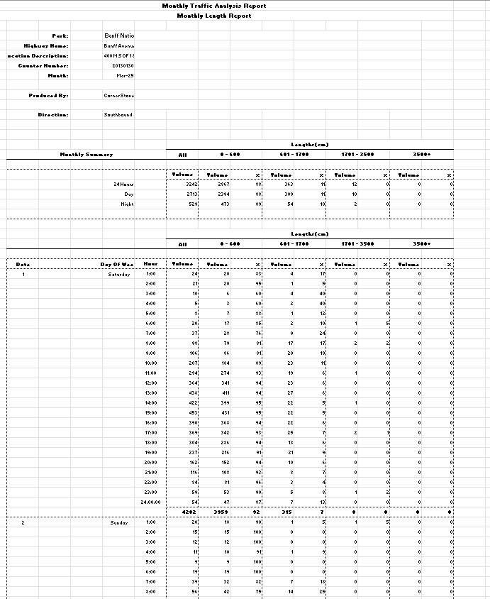
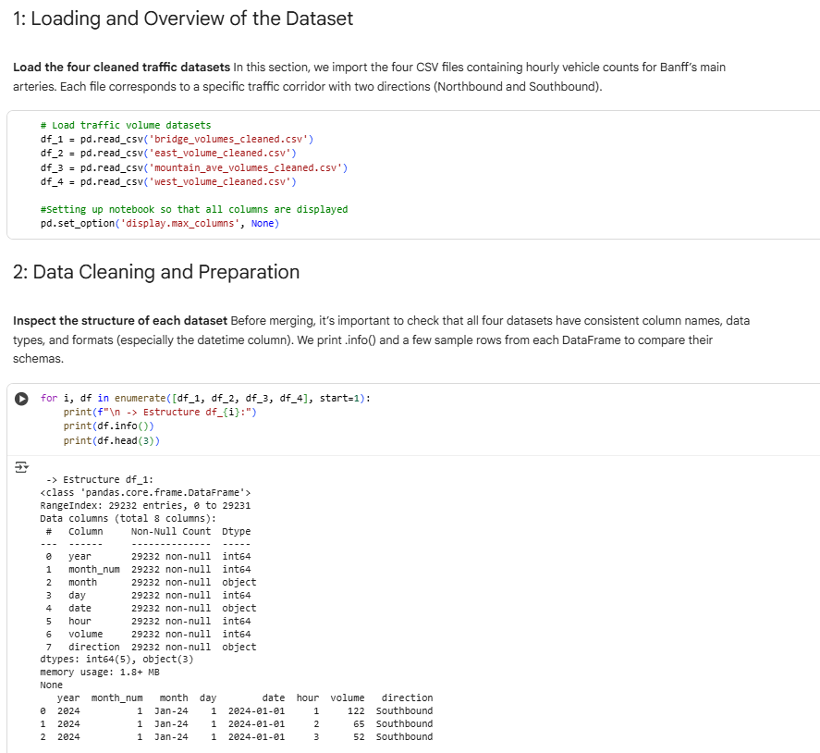
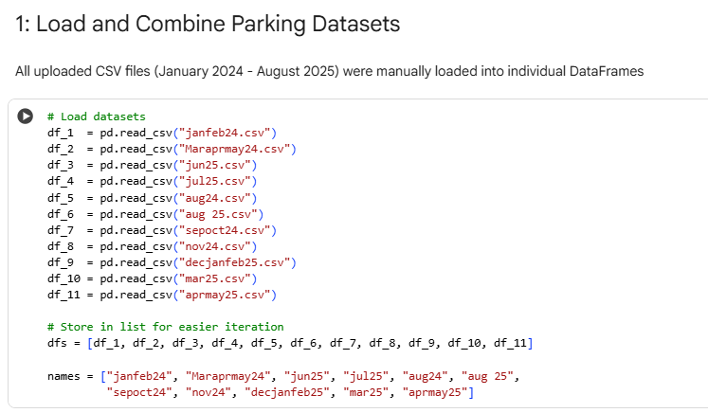
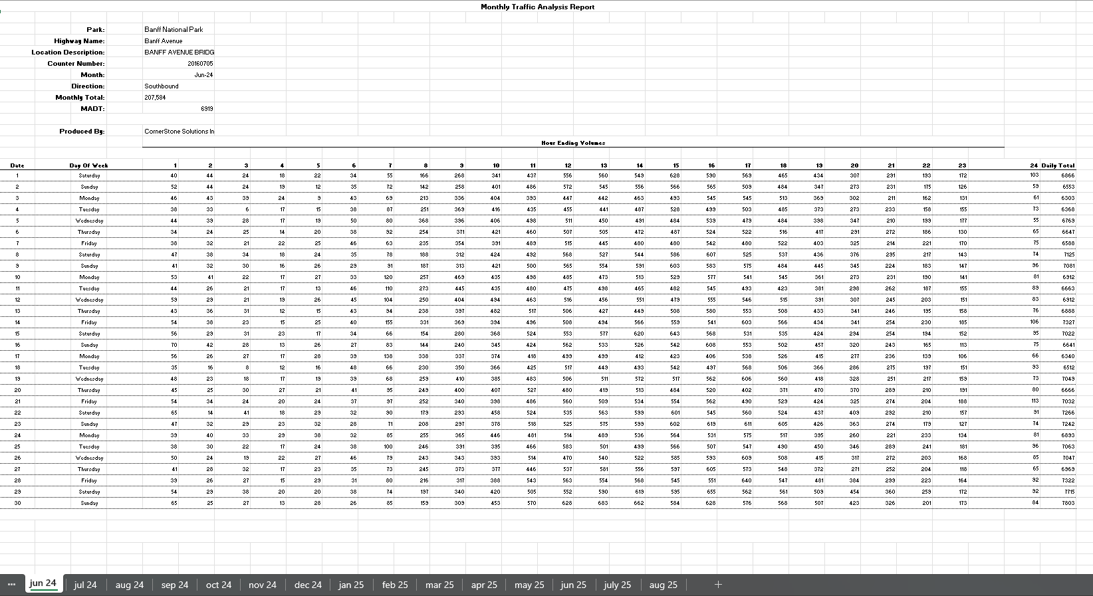
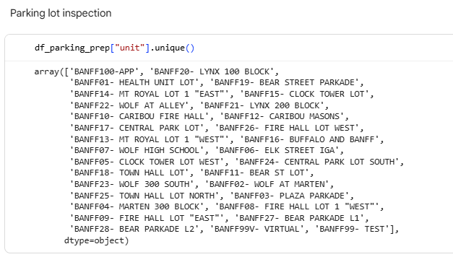
Data
Traffic Volume
Parking
Features: Fee, Date, Starting date, End date, Payment type, Amount, Plate, Type, Hope Gps Latitude, Hope Gps Longitude, Unit, Time, PT1 amount, Amount with bonification, Zone.
Features: year, month_num, month, day, date, hour, volume, direction, artery.
CornerStone Solutions Inc

Slide 6
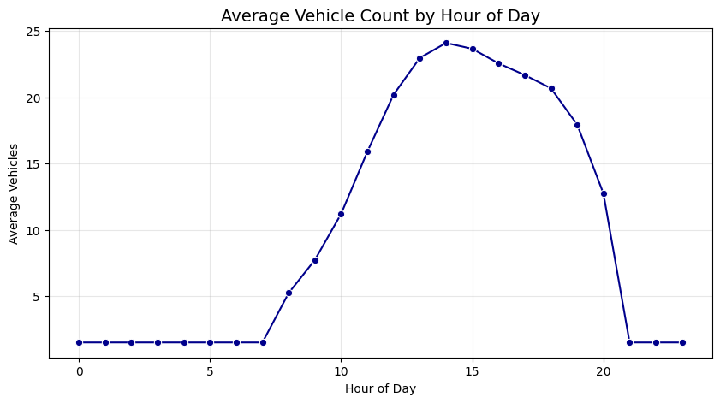
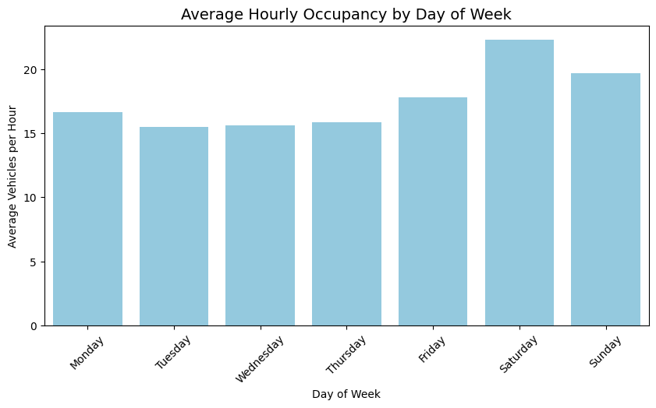
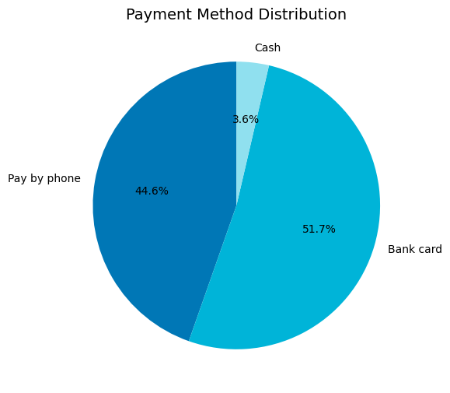
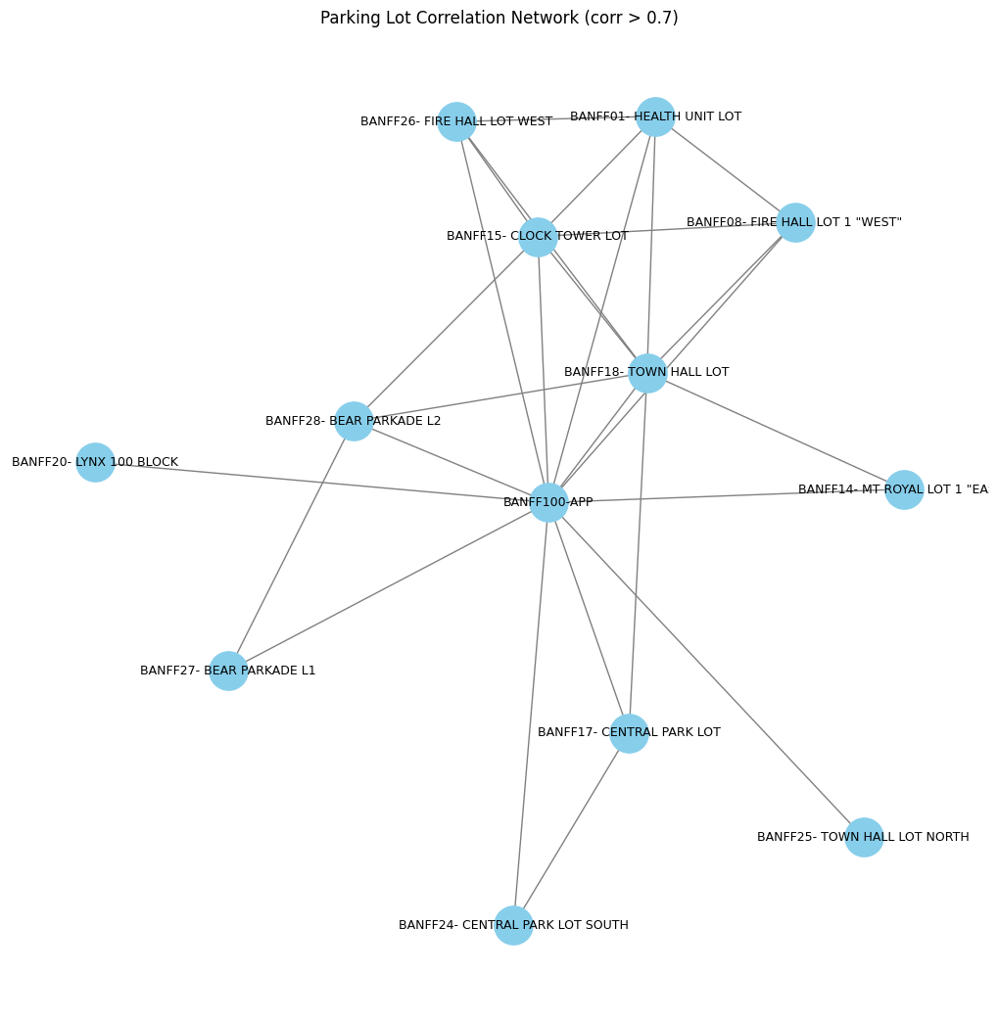
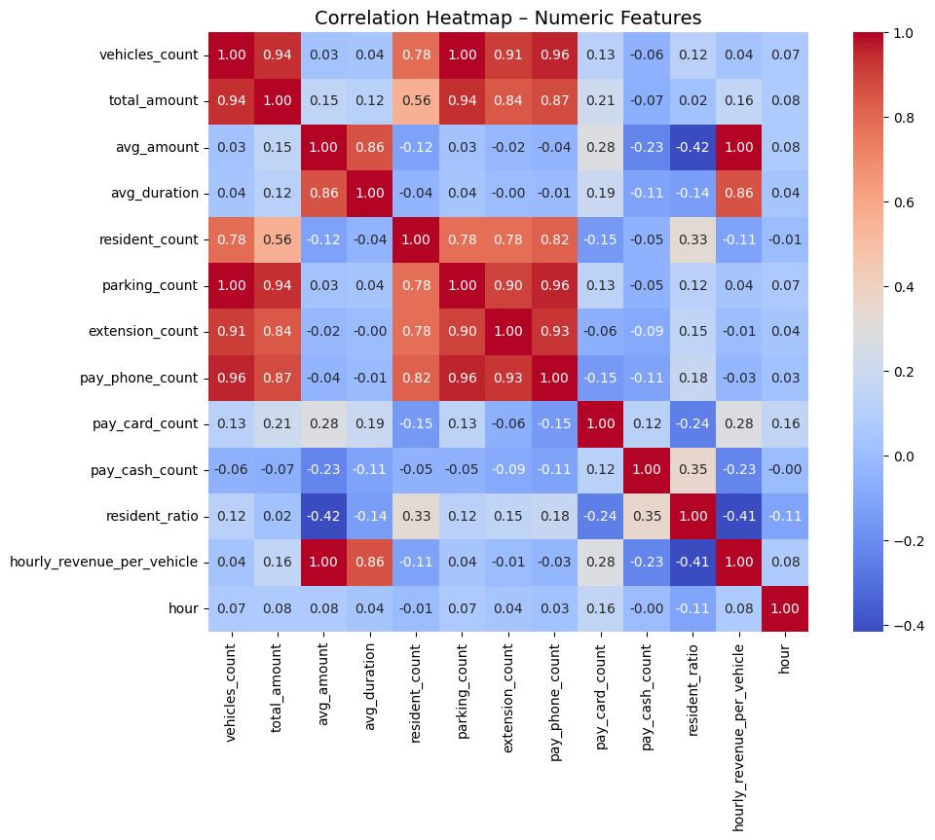
Parking

Slide 7
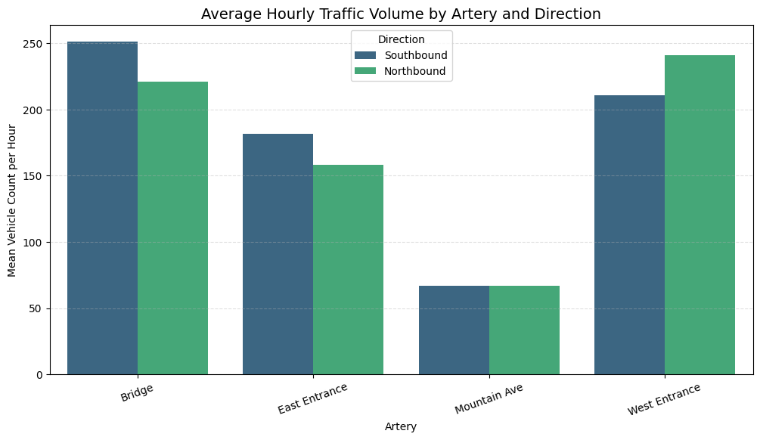
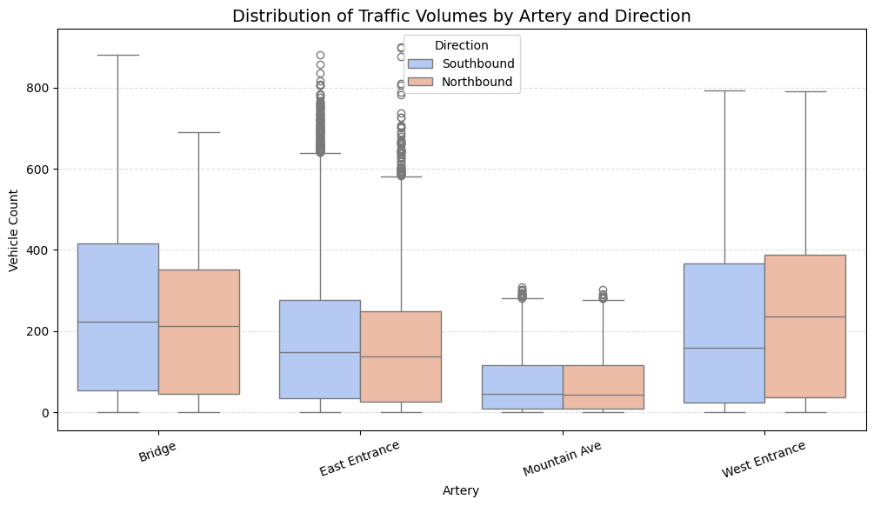
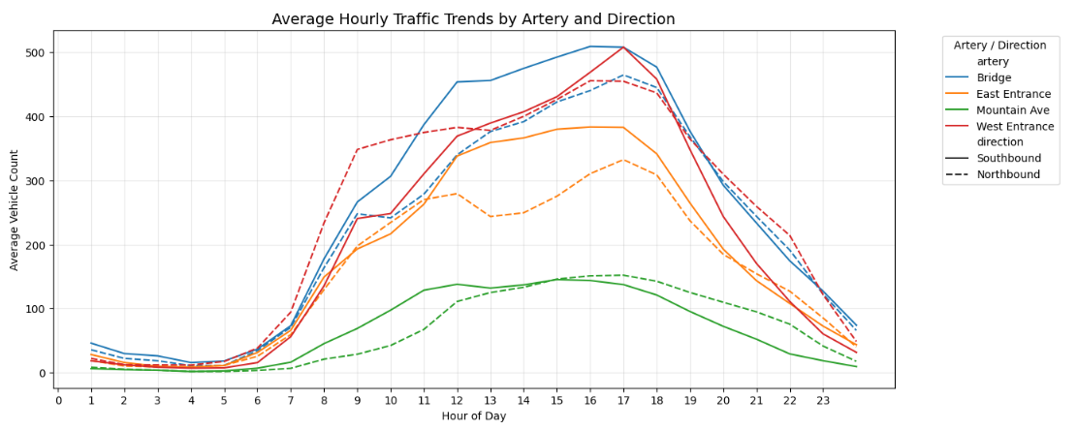
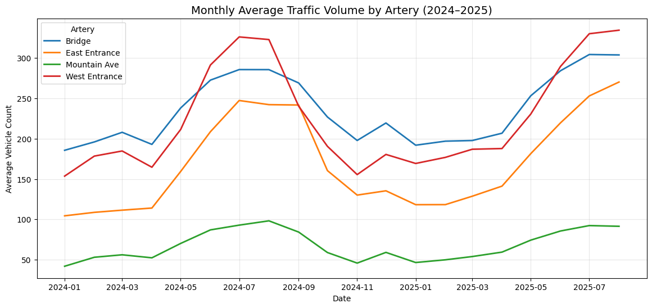
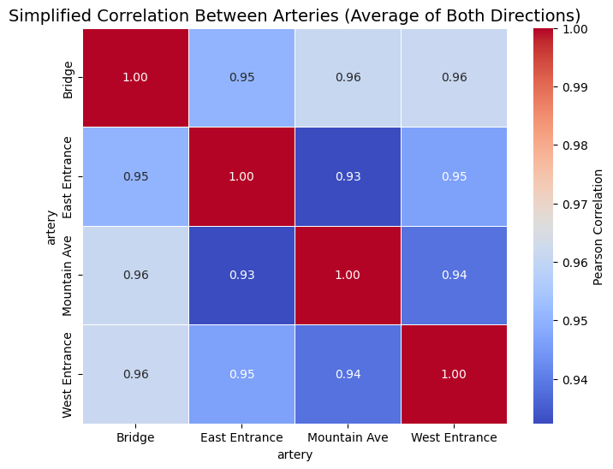
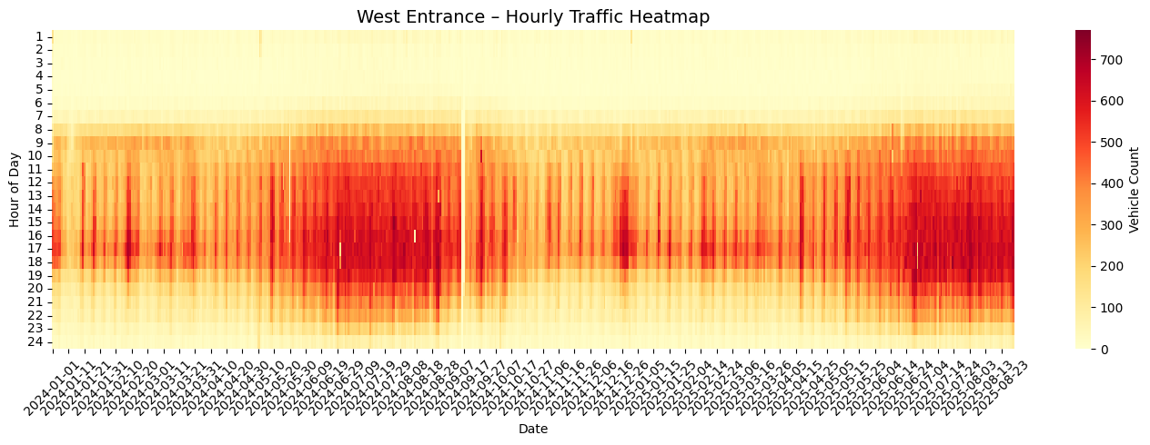
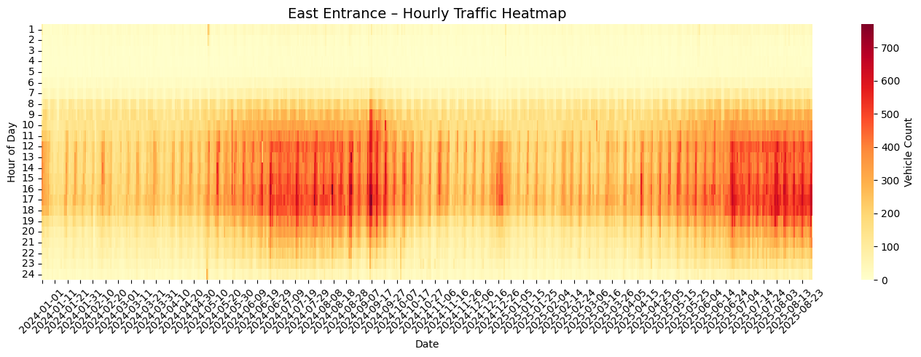
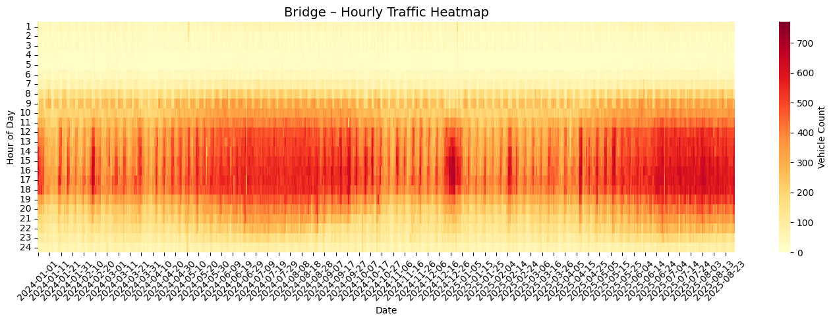
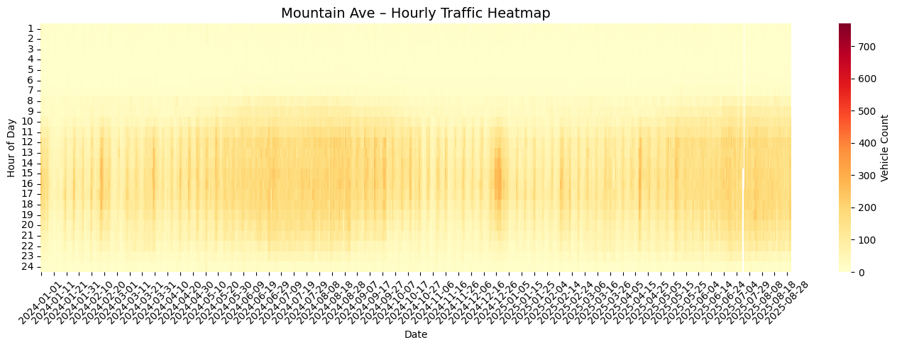
Traffic

Slide 8
Traffic

Slide 9
Traffic

Slide 10
Traffic

Slide 11
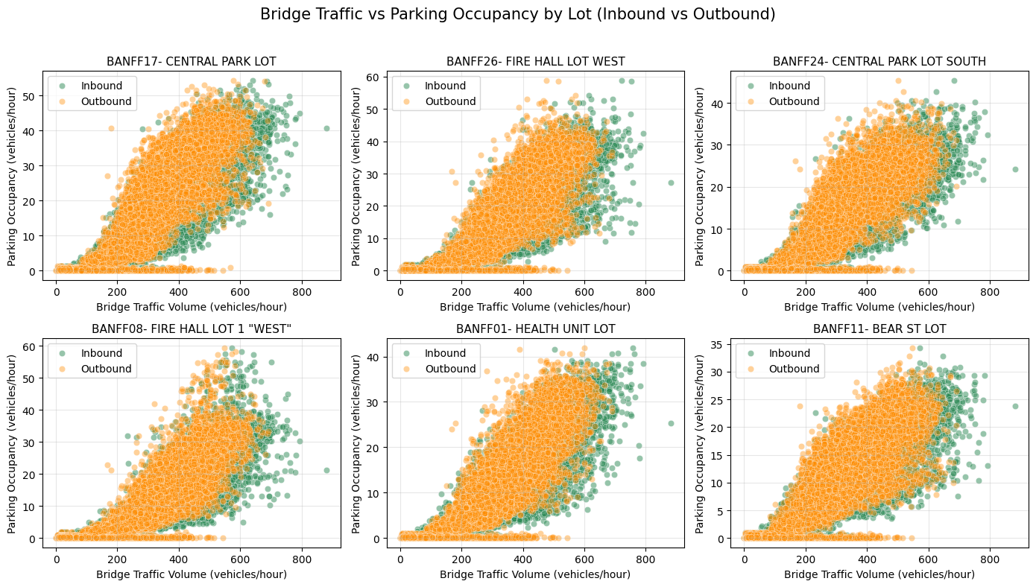
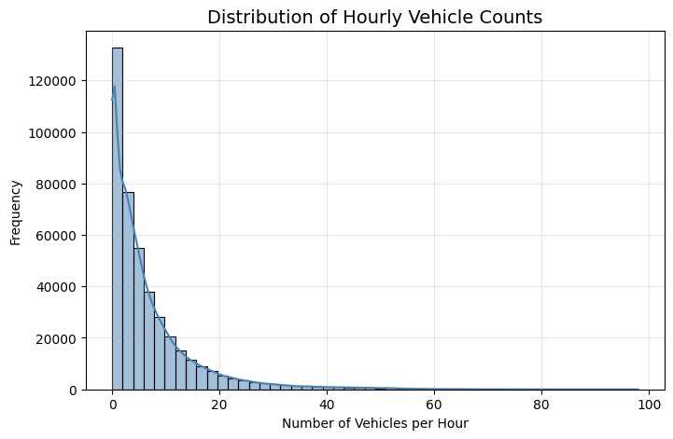
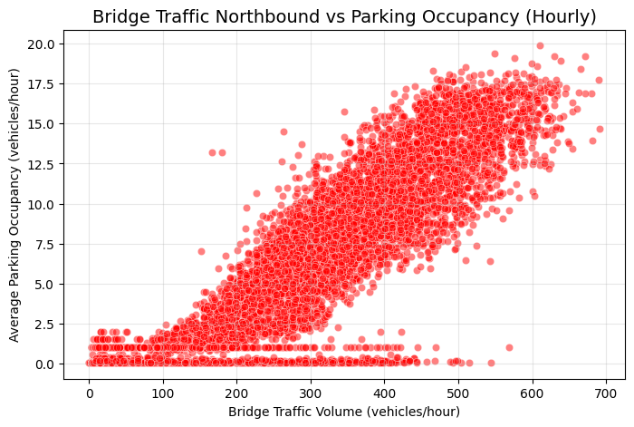
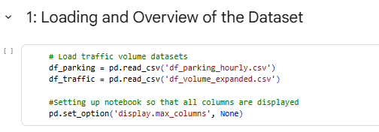
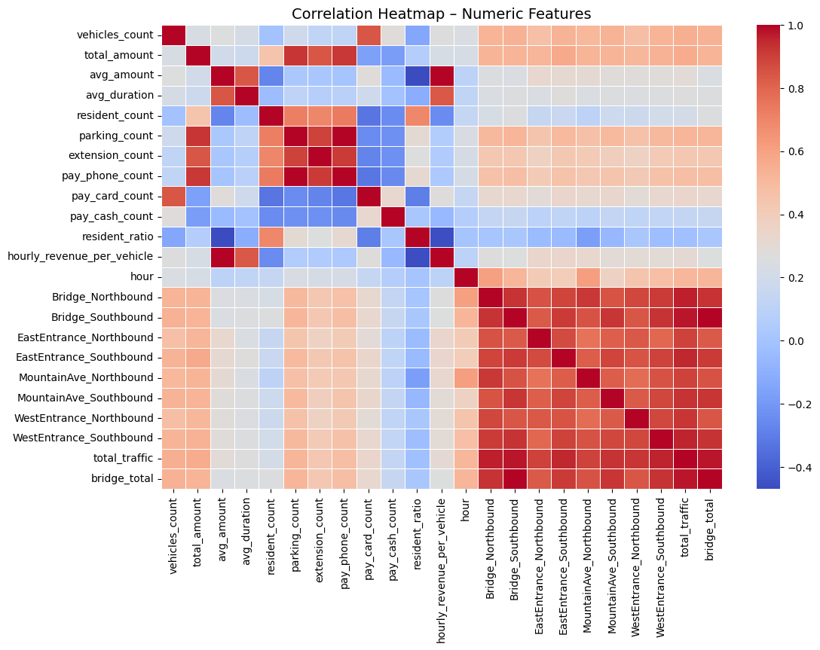
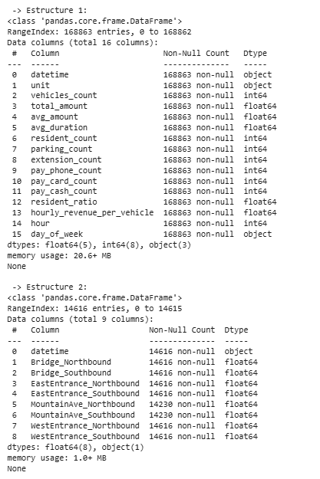
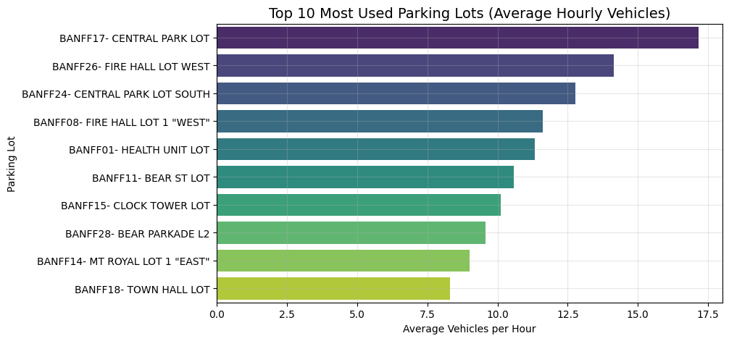
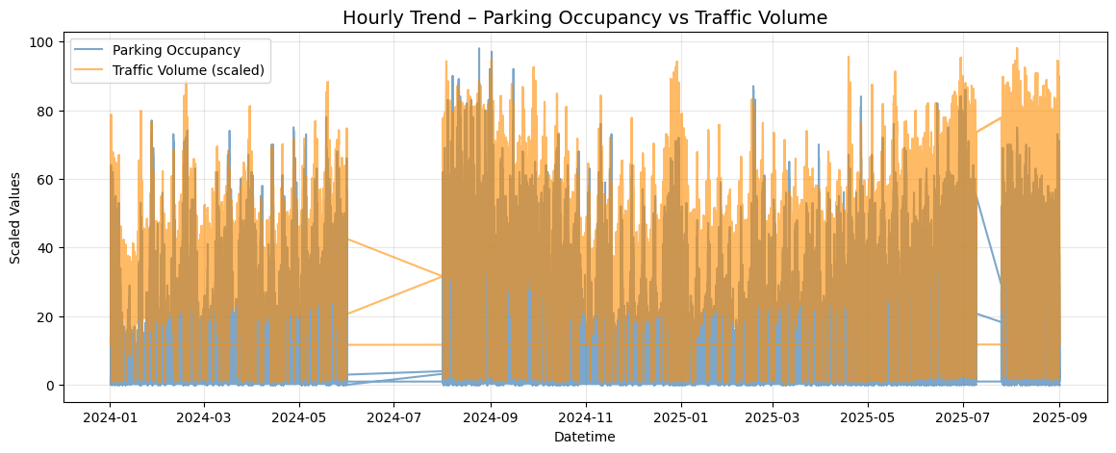
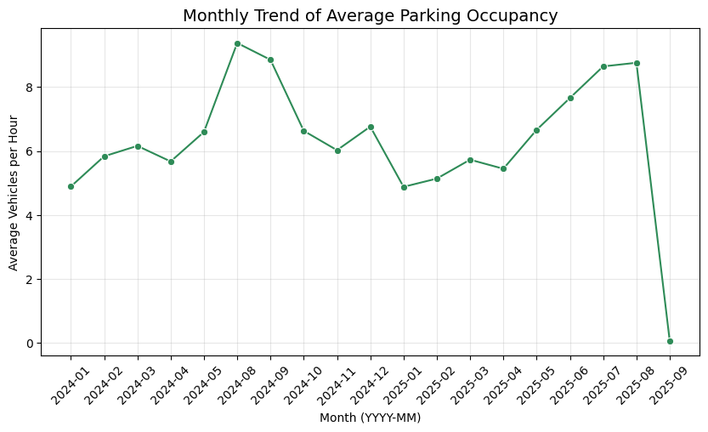
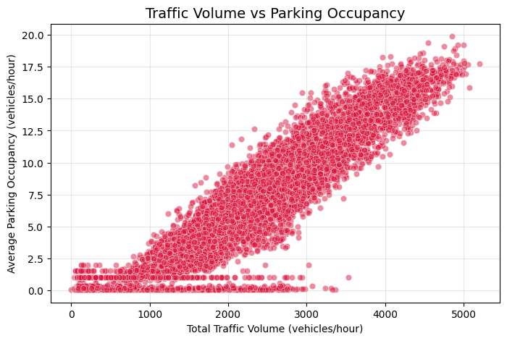
Consolidated EDA

Slide 12
Consolidated EDA

Slide 13
Consolidated EDA

Slide 14
Conclusions
Data Availability Challenge
Insights from Exploratory Analysis
Reframed Problem Statement for Real Value
Predict parking duration (Regression).
Forecast overall parking demand (Time-Series).
*by aligning our problem statement with the true structure of the data, we transform a limitation into an opportunity — focusing our analysis where it can produce the most actionable insights for the client.
Notes:
One of the main challenges identified during this project was the limited spatial information for transactions made through the Banff Parking App, which represent nearly 50% of all parking records. Because these app-based transactions do not include a fixed parking location, the original modeling objective — predicting occupancy per parking lot — could not be achieved without introducing strong assumptions that would compromise model reliability.
2. Despite this limitation, the data analysis provided valuable insights:
Parking follows a clear daily cycle, with peak demand between 10 AM and 5 PM, especially on weekends and summer months.
Parking demand is higher from June to August, reflecting Banff’s tourism season, while winter months show lower activity.
App users park more frequently but for shorter periods, while on-site payments show longer stays and higher spending, suggesting different usage profiles between residents and visitors.
These insights already contribute to a better understanding of citywide parking dynamics.
3. In response to the data constraints, the project scope was strategically redefined to focus on questions that can be fully supported by the available data and still deliver value to the client. The new problem statements aim to:
Predict parking duration (Regression).
Forecast overall parking demand across time and payment modes (Time-Series / Analysis).

Slide 15
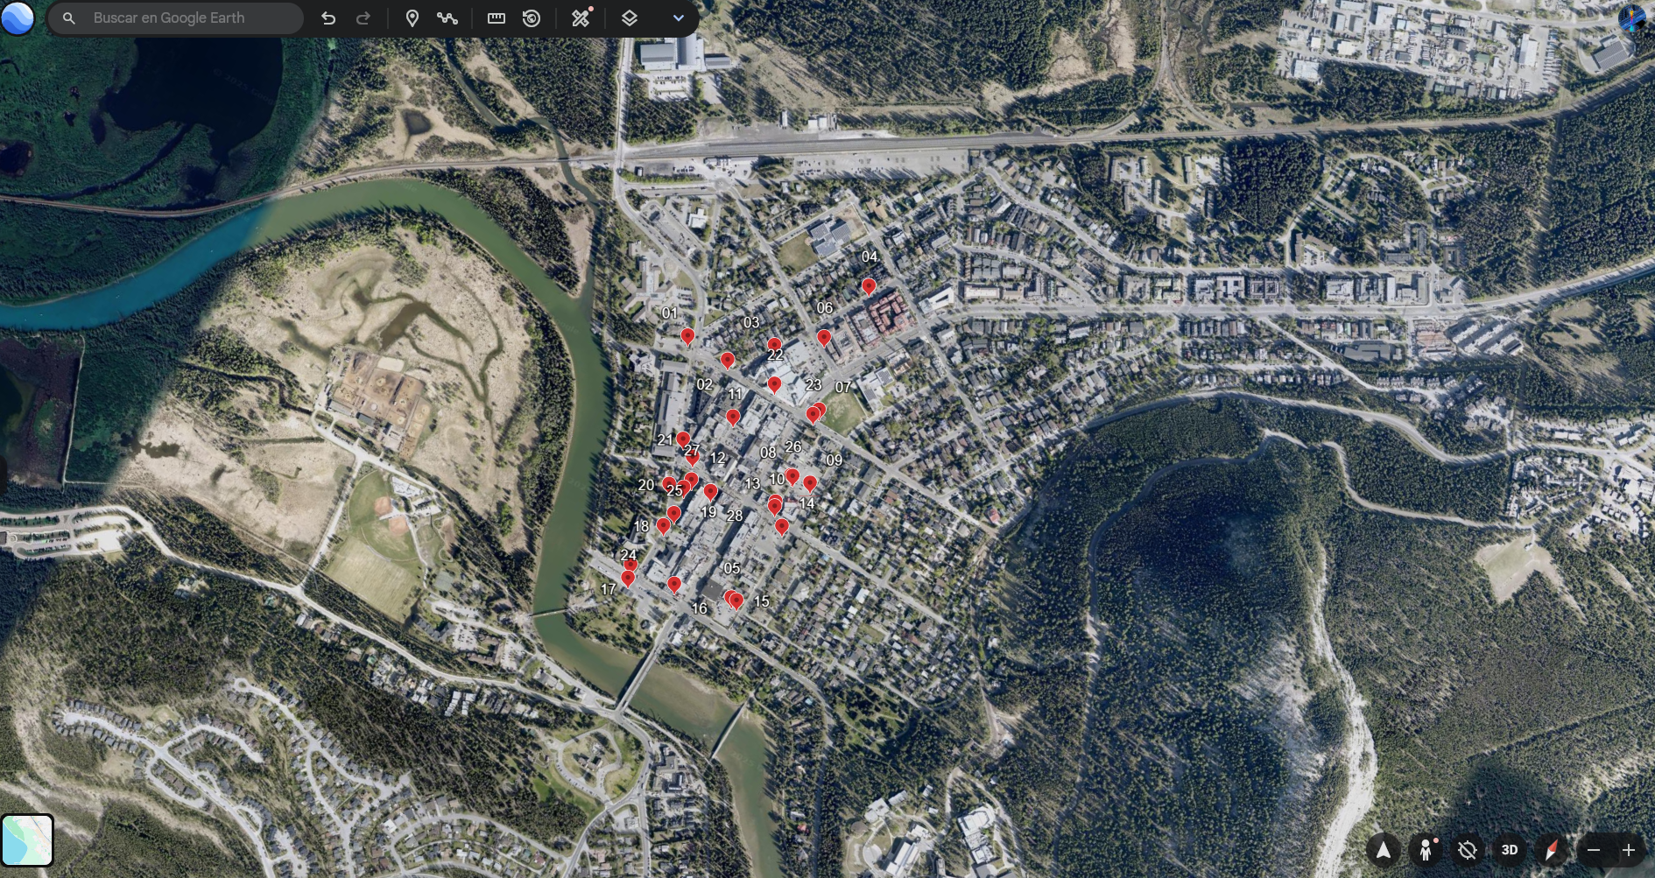
East Entrance
West Entrance
Bridge
Mountain Ave

Slide 16
Thanks!

